Slide 1
CAPSTONE PROJECT
Shopping Intention Prediction using
ANN
Final Project
Presented By
SATHYA S
711721244047
III BTech CSBS
KGISL Institute of Technology
3/21/2024 Annual Rev iew

Slide 2
PROJECT TITLE
Predicting the accuracy of Shopping Intention of customers purchasing through online platforms using Artificial Neural Network.
3/21/2024 Annual Rev iew

Slide 3


AGENDA
Problem Statement
Project Overview
End Users
Solution and Value Proposition
The Wow Factor in Your Solution
Modelling
Results
3/21/2024 Annual Rev iew

Slide 4

PROBLEM STATEMENT
Problem: Understanding and predicting consumer shopping intentions is crucial for businesses to optimize marketing strategies and enhance customer experiences.
Challenge: Traditional methods may not effectively capture the complexities of consumer behavior, leading to inefficiencies in targeting and engagement.
Objective: Develop an Artificial Neural Network (ANN) model to accurately predict
shopping intentions based on various factors.

Slide 5

PROJECT OVERVIEW
Objective: To predict consumer shopping intentions using ANN.
Approach: Utilize historical data on consumer behavior, demographic information, and online interactions to train the model.
Methodology: Implement a multi-layer perceptron (MLP) ANN architecture for predictive analysis.
Tools: Python, TensorFlow/Keras for ANN implementation, and relevant data
visualization libraries.

Slide 6

WHO ARE THE END USERS?
End Users: Retailers, E-commerce platforms, Marketing agencies.
Importance: Helps businesses tailor marketing efforts, personalize recommendations, and optimize inventory management.
Benefits: Enhanced customer engagement, increased conversion rates, and improved ROI on marketing investments.
3/21/2024 Annual Rev iew
6

Slide 7

YOUR SOLUTION AND ITS VALUE ROPOSITION
Solution: Develop an ANN model capable of accurately predicting consumer shopping intentions.
Value Proposition:
Precision: Leverages advanced machine learning techniques to provide precise predictions.
Scalability: Adaptable to varying business sizes and industries.
Efficiency: Streamlines marketing efforts by targeting the right audience with tailored campaigns.
Competitive Edge: Empowers businesses with insights into consumer behavior, enabling proactive strategies.
‹#›

Slide 8

THE WOW IN YOUR SOLUTION
Personalized Recommendations: Recommends products based on individual preferences and past behavior.
Real-time Insights: Provides instant feedback on changing consumer trends and preferences.
Interactive Interface: User-friendly interface for businesses to explore and interpret predictions easily.
Continuous Learning: Adapts and improves over time with new data, ensuring accuracy and relevance.
‹#›

Slide 9
MODELLING
Data Preprocessing: Cleaning, normalization, and feature engineering.
Model Architecture: Multi-layer perceptron (MLP) with multiple hidden layers.
Training Process: Splitting data into training and validation sets, optimizing hyperparameters, and iterative training.
Evaluation Metrics: Accuracy, precision, recall, and
F1 score to assess model performance.
‹#›

Slide 10
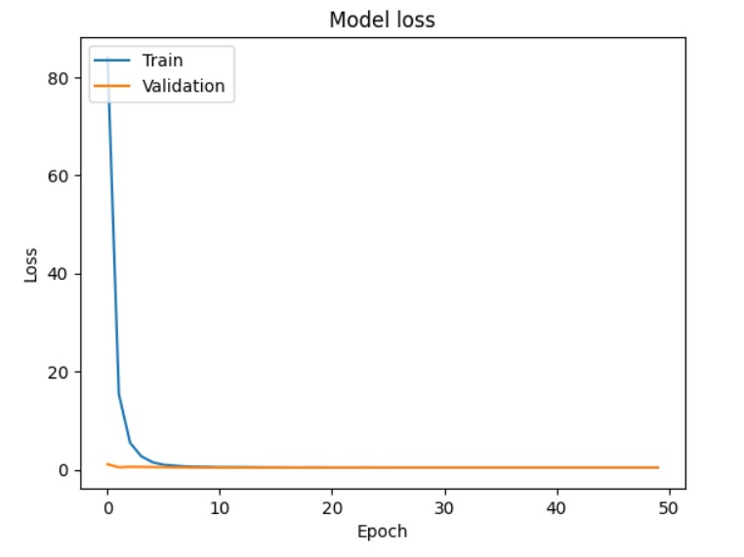
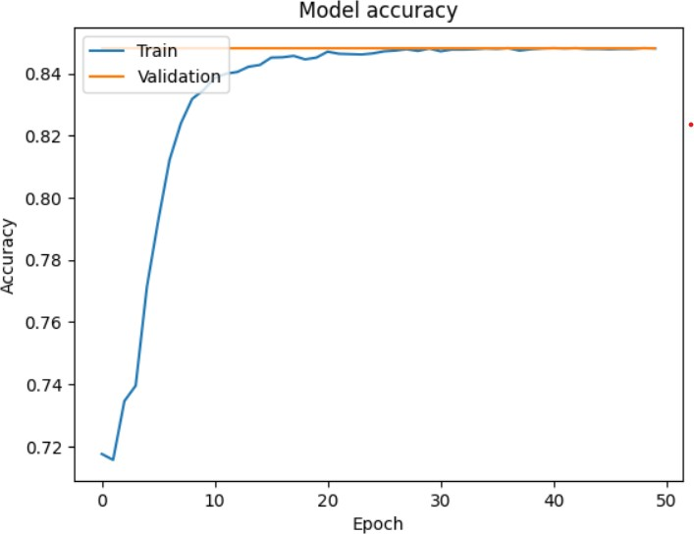
RESULT:
Demo Link: https://drive.google.com/file/d/1C1KDzAu4STZHWuiR9TYFlMN_39QU6aRr/view?usp=sharing
‹#›

